Slide 1
PyXScat: framework, GUI for X-ray Scattering

Slide 2
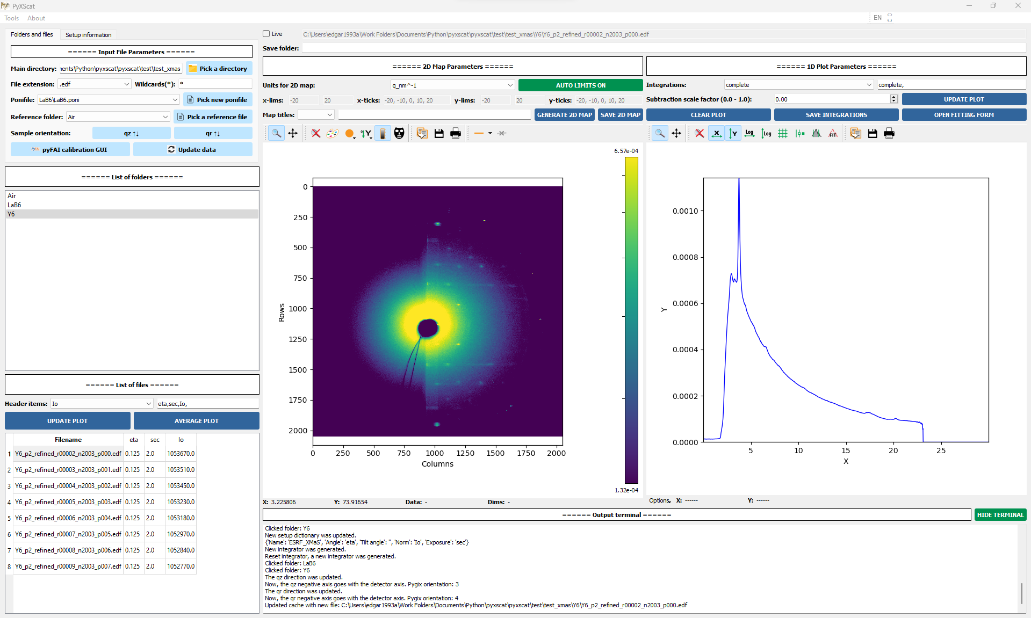
Description of PyXScat
The development of PyXScat was guided by three motivations:
Give the non-experienced user an interactive tool to visualize 2D scattering maps with a minimum learning curve.

Slide 3
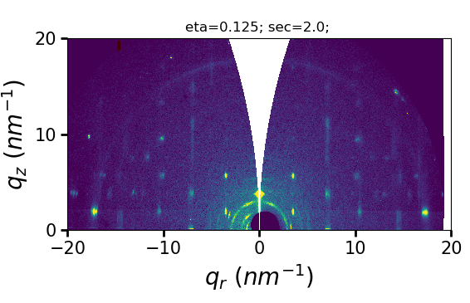
Description of PyXScat
The development of PyXScat was guided by three motivations:
Develop a combined abstraction between FabIO, pyFAI and pygix to incorporate the geometric corrections required for grazing incidence experiments.

Slide 4
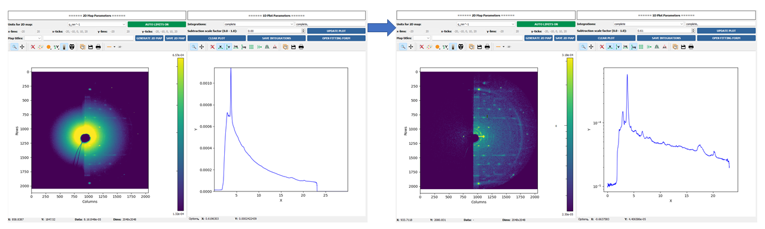
Description of PyXScat
The development of PyXScat was guided by three motivations:
Allow a quick, tunable tool to subtract the background from 2D maps and assess the quality of data during the experiment itself.

Slide 5
Description of PyXScat
The development of PyXScat was guided by three motivations:
Give the non-experienced user an interactive tool to visualize 2D scattering maps with a minimum learning curve.
Develop a combined abstraction between FabIO, pyFAI and pygix to incorporate the geometric corrections required for grazing incidence experiments.
Allow a quick, tunable tool to subtract the background from 2D maps and assess the quality of data during the experiment itself.
IN SUMMARY: Develop a straightforward (and limited) tool as a bridge between the first visualization and assessment of the collected data and the deep analysis of these data, which is meant to be done using other softwares.

Slide 6
Functionalities of PyXScat
These are the current functionalities of PyXScat graphical user interface:
Browsing of the data files (e.g. .edf) located within a root directory.
Browsing of the metadata stored within each data file: metadata extracted with FabIO module.
Automatic detection of new data files within the root directory (only available on Linux machines).
Visualization of raw scattering maps collected with 2D detectors.
Visualization of 1D integration profiles. The integration is performed with pygix/pyFAI engines.
Interactive form to design integration ‘cakes’ and ‘boxes’ that will be interpreted by pygix/pyFAI.
Tunable reference subtraction of both 2D patterns and 1D integrated profiles.
Automatic searching of the reference file according to the exposition time of data files.
Saving tool to store 1D integrated profiles into .dat files.
Generator of 2theta(deg, rad) or q(nm-1, A-1) 2D maps, with proper curvature and missing wedge corrections.
Design and saving tools to modify and store 2theta/q maps.
Future functionalities, not available on March 2023:
Handling of .hdf5 files.
Communication with peak fitting tools.

Slide 7
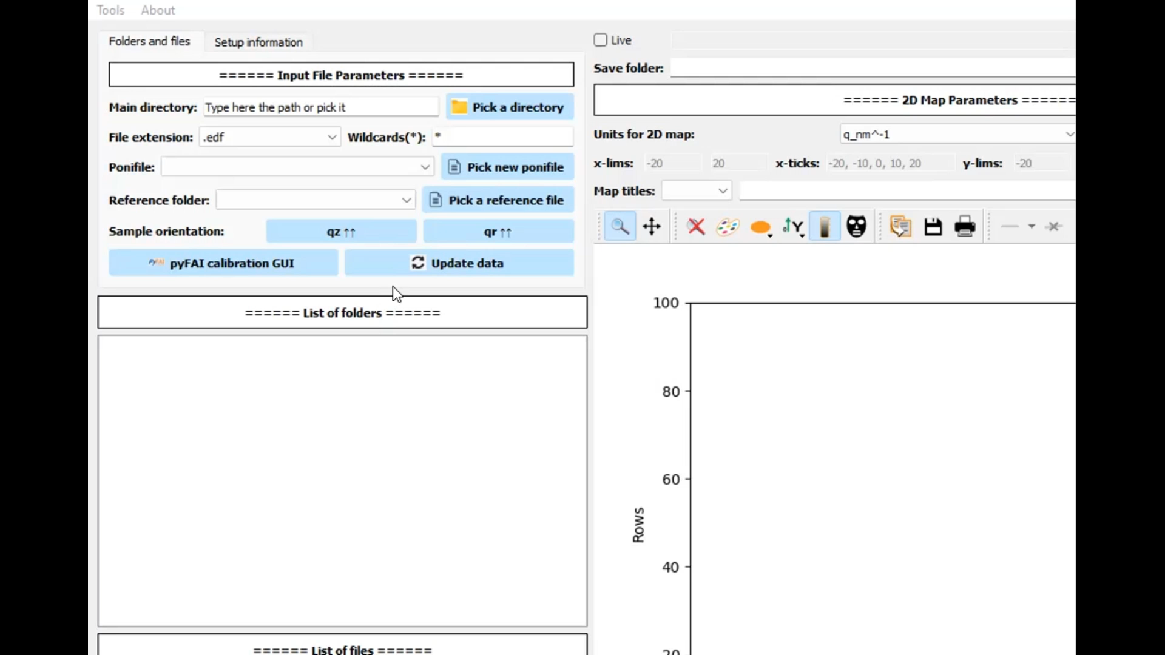
Choose the main directory
The main directory is the root folder where all the data files are stored.
The software will search recursively inside the main directory for all the files that matches with the extension (default: .edf) and wildcards (e.g. *sample2*0000*, default: *).
This is the only required step to start visualizing data.

Slide 8
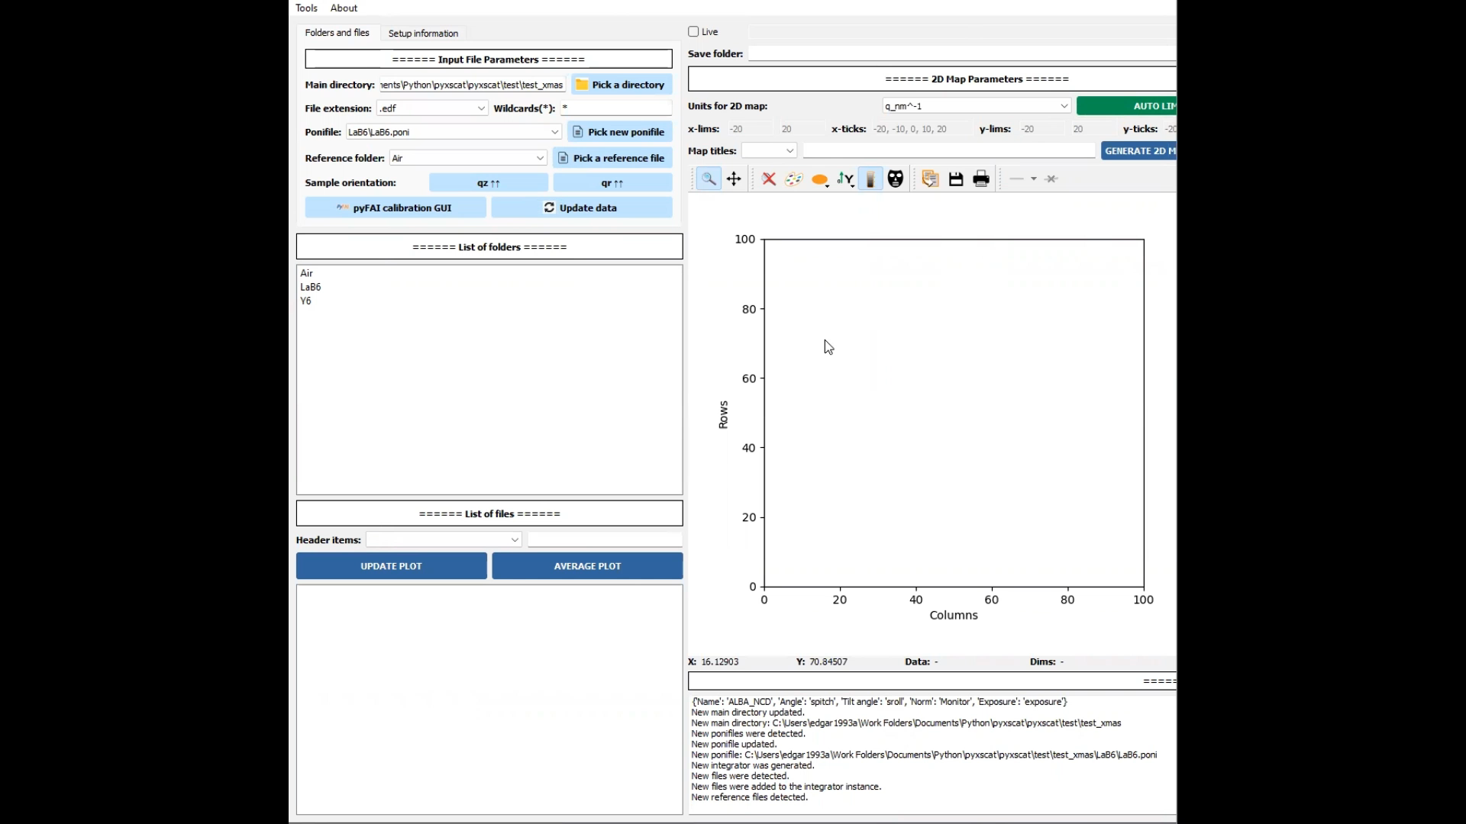
2) Choose the dictionary with setup information (optional)
The setup dictionary contains five items with the names of certain counters and motors that will be important during handling of data:
Incident angle (e.g. ‘spitch’)
Tilt angle (e.g. ‘chi’)
Normalization factor (e.g. ‘Monitor’)
Exposition time (e.g. ‘exposure’)
PyXScat has an interactive form to generate new setup dictionaries.

Slide 9
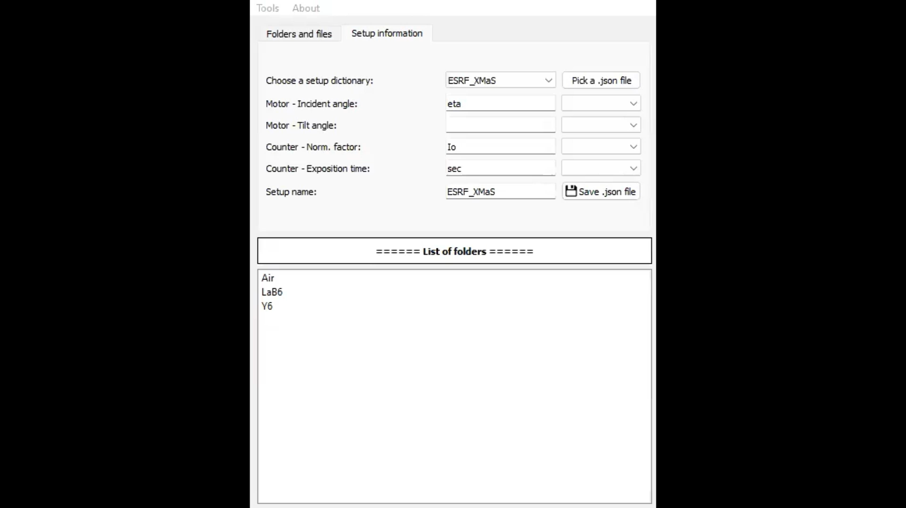
3) Choose .poni files and Reference folders (optional)
The whole procedure of data reduction from scattering/diffraction experiments is based on pyFAI module, that requires a .poni file, that contains enough information about the experiment to integrate the 2D patterns.
The software loads automatically all the .poni files within the main directory, and loads the first one.
A reference folder can be chosen to subtract data: e.g. a folder with .edf files with scattering from the air/substrate.
Ponifile step is not required to visualize the raw map but mandatory to integrate the intensity into 1D profiles.

Slide 10
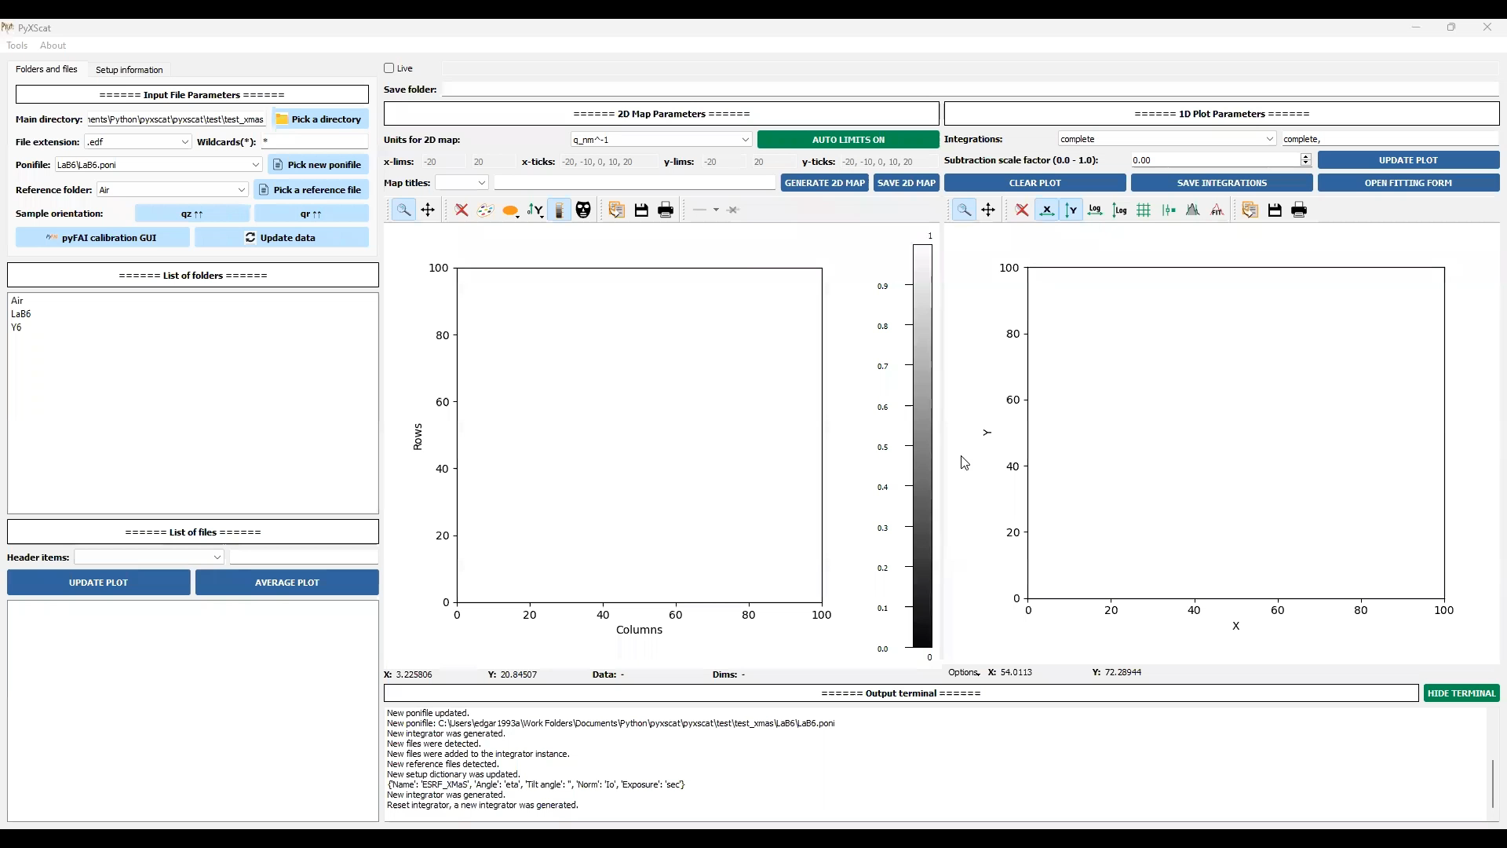
4) Folders browsing + Files/Metadata browsing + Plot
Click on one of the folders to display all the data files found in the folder (that matches extension and wildcards).
Click on one of the files will upload the scattering data in the cache of the software.
Click on the ‘UPDATE PLOT’ button will plot the data stored in cache: the raw 2D map on the right graph and the integrated profile on the left graph (if ponifile exists and there is a integration selected).

Slide 11
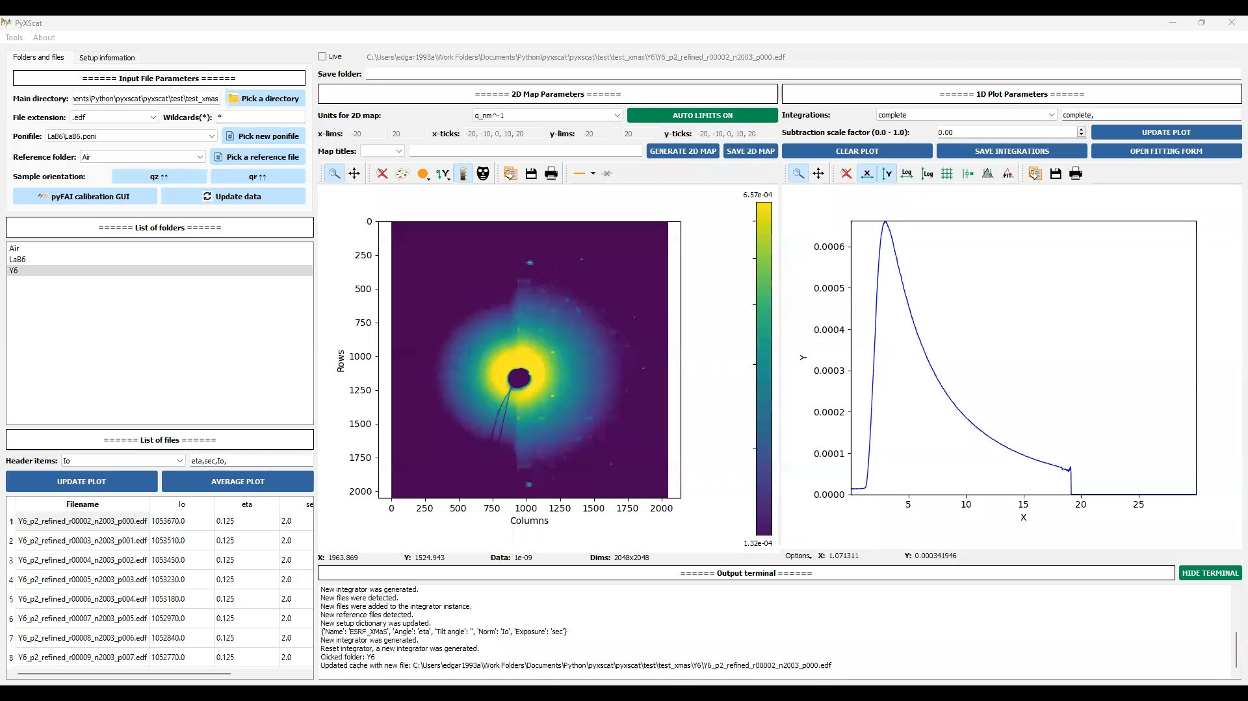
5) Adjust background subtraction
PyXScat finds automatically a reference file with the same exposition time as the data file. Change manually the factor scale which multiply the reference data and is subtracted from the sample data. UPDATE PLOT to visualize the change.

Slide 12
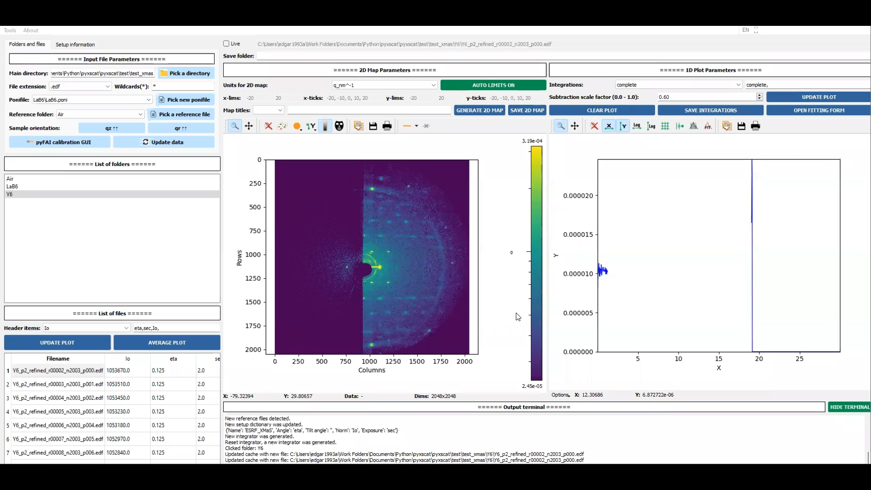
6) Adjust sample orientation
PyXScat allows to change the default rotation of the detector/sample through ‘sample_orientation’ parameter of the pygix module.
PyXScat modifies this parameters through two buttons: parallel/antiparallel qz and qr axis. There are only four sample_orientations. It is recommended to click on GENERATE 2D MAP to visualize the possibilities.
IMPORTANT: the sample orientation determines the 1D integration since it is using pygix module.

Slide 13
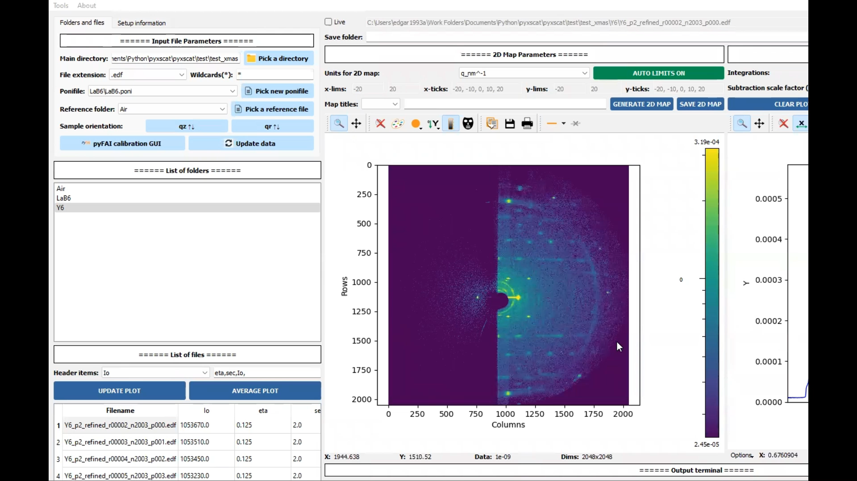
7) Adjust image style
PyXScat allows to modify the style of the generated reciprocal maps: units (nm-1, A-1, deg, rad), limits of the maps, ticks and titles associated with file metadata.

Slide 14
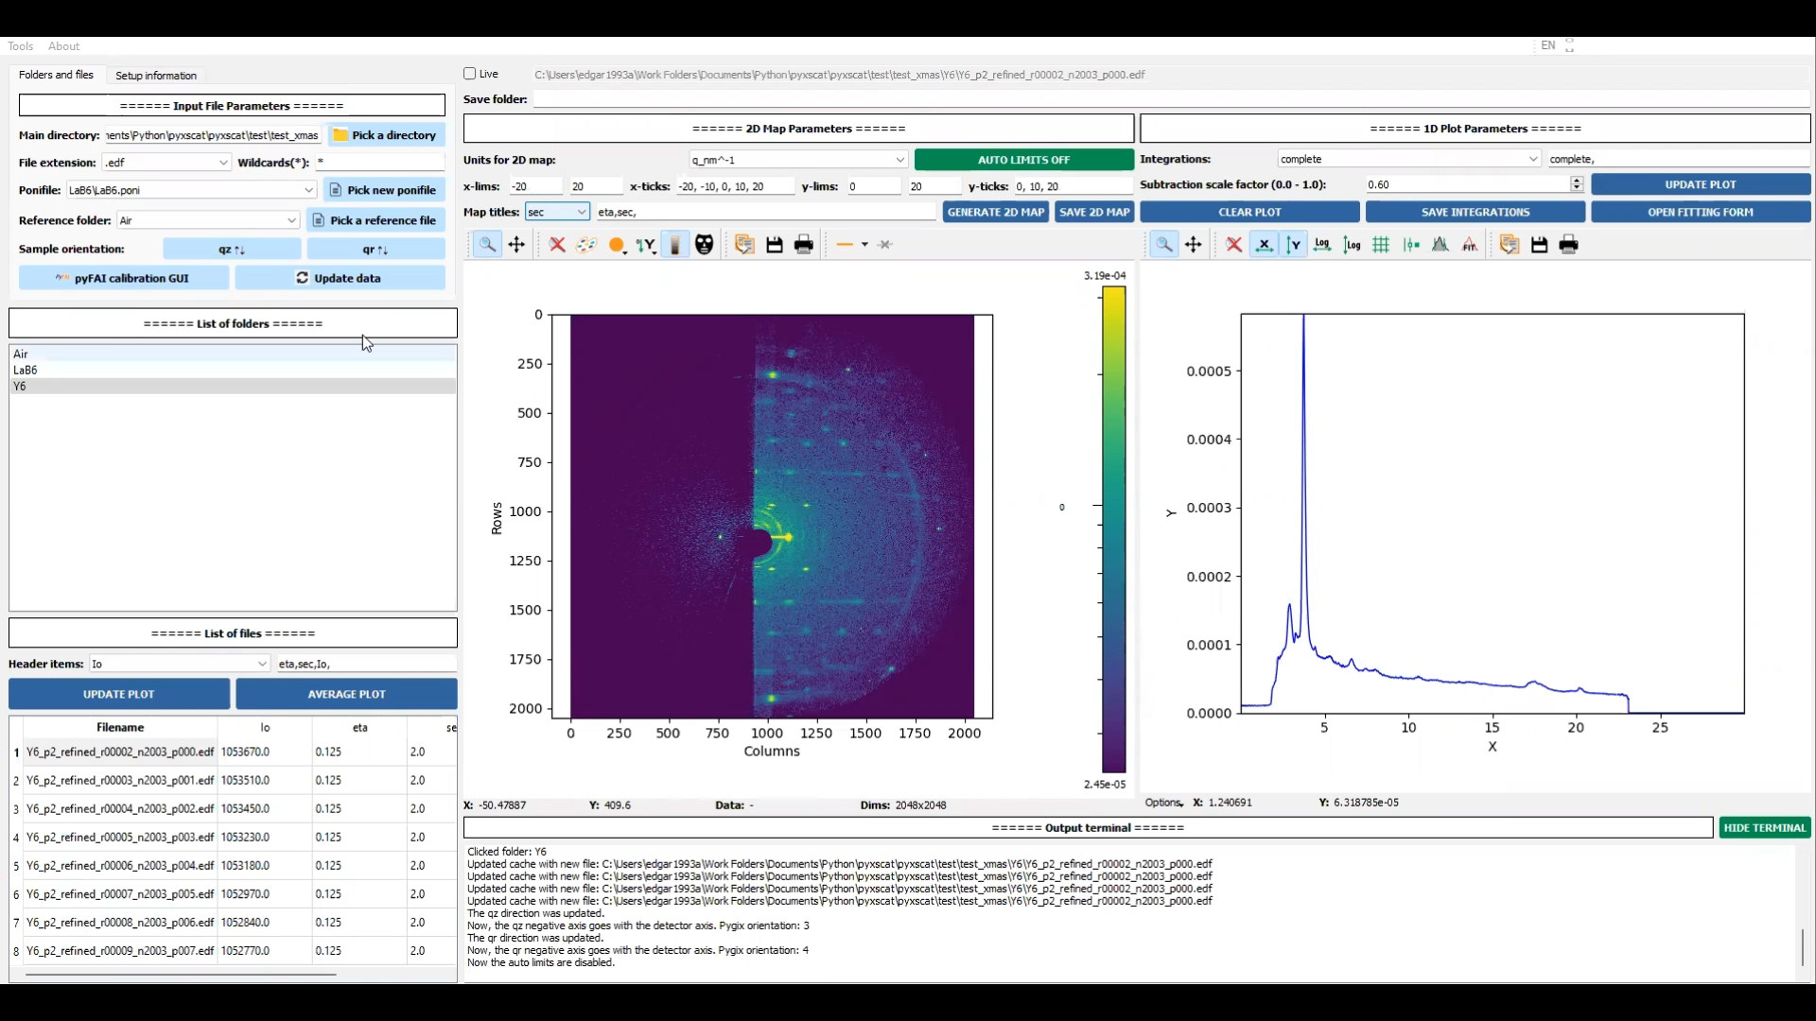
8) Open pyFAI calibration GUI
PyXScat is connected with the pyFAI calibration GUI just by clicking on the pyFAI button. GUI from pyFAI is recommended to generate .poni files from some calibration data (LaB6, AgBh, Cr2O3…).

Slide 15

9) Add setup and integration dictionaries
PyXScat contains interactive forms to generate new setup dictionaries and new integration templates to slice the 2D patterns in ‘cakes’ and ‘boxes’.

